Slide 1
Home Automation using Node MCU

Slide 2
Basic Logic Flow
Control Device
(Client)
Eg. Google Assistant
Dashboard
(Broker)
Receiving Subscriber
(Client)
Eg. NodeMCU
Relay
Particular Switch/Sensor

Slide 3
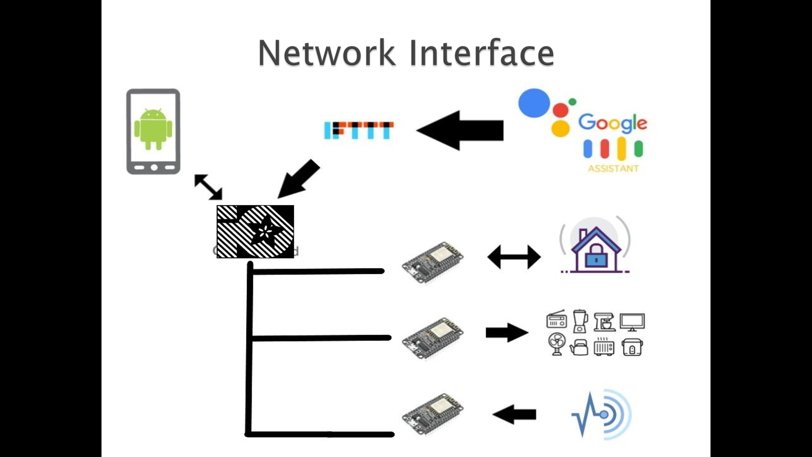

Slide 4
Adafruit Dashboard
1) io.adafruit.com
2) Create account
3) Create dashboard
4) Copy KEY.

Slide 5
Code For Home Automation
Code: HomeAutomation\HomeAutomation_wo_DHT11\HomeAutomation_except_DHT11\HomeAutomation_except_DHT11.ino
1) Change Wi-fi SSID and Password
2) Change AIO username and key.
3) Change name of the feeds appropriately.

Slide 6
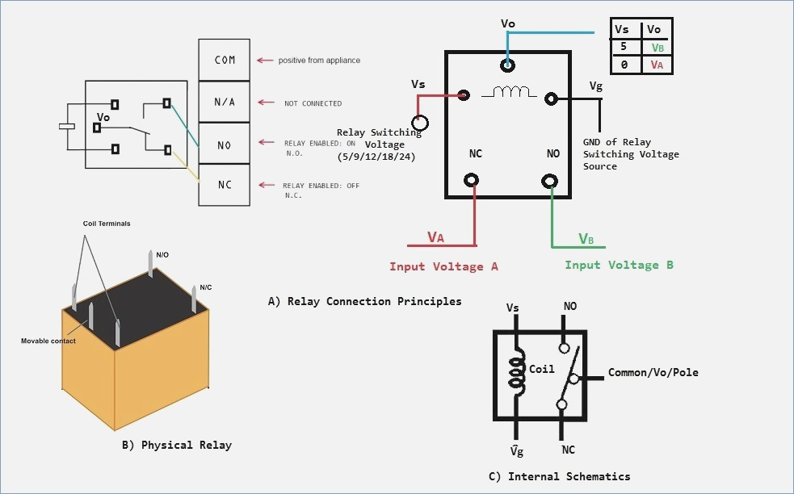
Relay

Slide 7
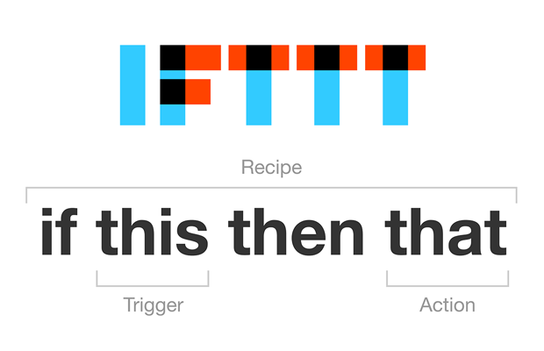
IFTTT
IF This Then That
Enables us to send messages(through MQTT) to the dashboard to perform certain functions.

Slide 8
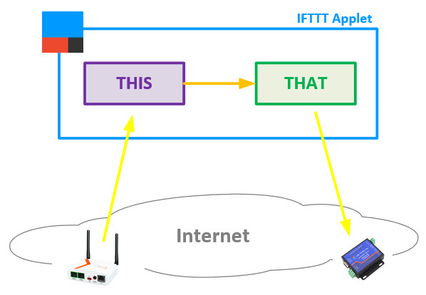
Trigger used in our application

